Slide 1




TDSB Education app
By: Arian, Brandon, Josh, Michael, Nikita, Robert, and Victor

Slide 2


Toronto District School Board
Partner is Veronica Broomfield
Goal to replace paper agenda
Integrate Google Classroom
Notes:
Arian (part of 5min demo)
Partner is Veronica, a teacher at a school in the Toronto district school board. She wants this app to be used for her classrooms as a replacement for the paper agenda.
A key criterion was that they wanted integration with google classroom to pull data from all the assignments they have on their classes and to get their due dates.

Slide 3


Users
Mainly used for students to set goals
Idea is for them to be independent, little teacher interaction
Notes:
Arian (part of 5min demo)
The main idea is for students to improve on their goal setting and time management skills. Our partner also emphasized the important of self regulation, so they wanted limited intervention from the teachers to the students in the app.
They also want to make use of students personal devices so they always have access to the goals they set and their upcoming assignments.

Slide 4

Demo
Notes:
Arian 5min: We do a walkthrough of adding a goal, show how it updates on all screens.
CLEAR GOALS FROM SETTINGS BEFORE START
Make one goal in the past to show completed late. One goal on current day, and one goal in future.
Show performance screen at each step, then when all goals are added show calendar screen.
After all this, go the my courses view, click on one course where you are student to show assignments.
Then click on course as a teacher to show you can see all students in that course.
ADD DUMMY GOALS TO SETTINGS TO SHOW APP SCALES

Slide 5


Deployment/Handoff
APK on Google Drive
GitHub repo shared
Option for partner to export to iOS in future
Notes:
Michael

Slide 6


Technical Item 1
Google authentication
Notes:
Josh (1min)

Slide 7

Technical Item 2
Flutter is a new framework only created recently
Documentation and online support is limited
Futures
Type wrapping data to be available in the future
Uncertain when it will be available
Allows to sync backend with the frontend UI
Notes:
Arian, will talk about the lack of documentation.
Victor talks about futures
1min
FUTURES:
Our application had to communicate with a lot of technologies over the web from validating our sign in through OAth2 keys to making calls to the classroom API and making requests to Firebase. Futures were interesting to work with as they are a type/concept that none of us have really encountered before. The idea is that it is a type that wraps data that will be returned in the Future, but it is uncertain when exactly in the Future it will be returned. Think of a web API call like a call to Classroom API. The challenge with this was to sync our backend and front end so that the front end is only loaded once the backend data is available. Otherwise a lot of funny and puzzlign errors would occur.

Slide 8
Technical Item 3 – Internal APIs
Creating internal APIs to connect Google Classroom and Cloud Firestore to our application
Written in Dart
ClassroomApiAccess – Wrapper for the Google Classroom API, allows us to pull information from Classroom
FirestoreManager – DAO that communicates with out database
Chose Firebase (NoSQL)
Notes:
One of the challenges we faced was connecting our application to all of the services that we needed. ClassroomApiAccess is a singleton that has methods for comminocating with the Classroom API, its purpose is to abstract away the Google Classroom types returned by Classroom API calls. It basically handles data conversion into types that we can use in Dart.
FirestoreManager is our DAO that abstracts away the database implementation from the rest of our code. It just communicates with our database and retrieves or sends the requested data.
We chose a NoSQL database because it was very easy to set up and learn how to use. It also allowed us for a lot more flexibility since our requirements changed rather quickly and with them changes the types of data that we have to store.
Very little data ends up being stored by the application, most of it resides in the database and is retrieved when necessary

Slide 9




Team Workflow
Personal communication: Discord
Organization and task distribution: Trello
Notes:
Josh (2min)

Slide 10

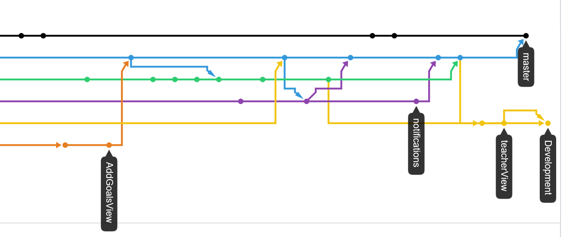
Team Workflow
Pull requests through GitHub
Notes:
Josh (2min)

Slide 11
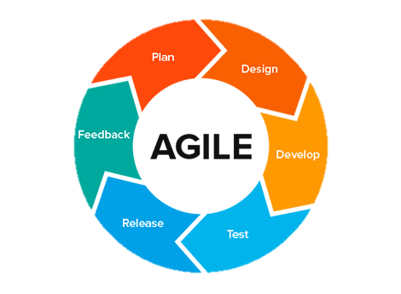
Team Workflow
Agile scrums bi-weekly
Notes:
Josh (2min total with last 2 slides)

Slide 12

Individual Contributions
Arian: Calendar view, add goal button on task view
Victor: Backend APIs, Performance View, Course Dashboard
Brandon, Robert: Goal pages (Adding goals, listing goals, etc.)
Nikita: Bottom Navigation, Notifications
Michael: Teacher view
Josh: Flutter/Firebase and Codebase setup, Login Page, Google Auth
Notes:
30 seconds each
Arian: Main contribution was calendar view. It takes in all the goals from firebase and displays them on the calendar based on their due dates. They show up as dots on the calendar. If you click on a day with goals, you see the goal title. The main lesson learned here was to learn how to use APIs with limited documentation. Flutter as a whole was new, but the calendar API is not a native API for flutter so reading about that with limited documentation was a challenge. Updating elements of the calendar was also new to me and I realized I was greatly limited by the attributes defined in the API. I had to work with the data structure the API used which in this case was a Map of events.

Slide 13
Thank you

